Slide 1
ASSIGNMENT 5 PROJECT TITLE: HOME SECURITY SYSTEM
GROUP: 4
SUBMITTED BY: STEPHY BABY C0753812

Slide 2
FINALIZING HARDWARE REQUIREMENTS
LPC 2148.
ESP32 CAM.
PIR SENSORS.
NRF24L01 RF TRANCEIVER.
ST7920 GLCD.
BUZZER.
18650 LI-ION BATTERY.

Slide 3
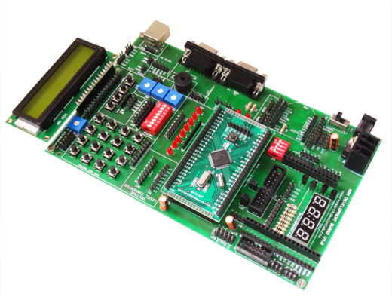
LPC 2148
This is an ARM7TDMI-S based high performance 32 bit microcontroller.
Flash memory: 32 KB to 512 KB.
Operating voltage: 3.3 V.
Has two 32 bit timers and it supports UARTs, SPI, SSP to I2C bus.
45 fast GPIO pins.
Works as a master MCU in the project.
Collects signal from RF receiver and give commands to ESP32.
Interfaced with LCD display and Buzzer.

Slide 4
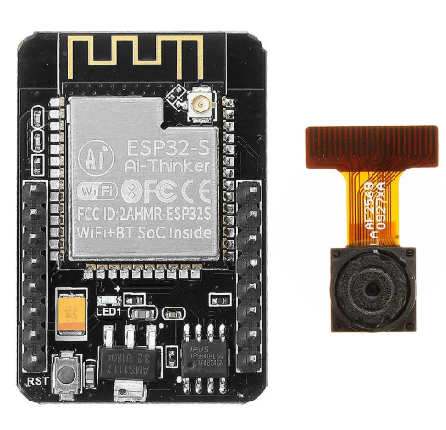
ESP 32-CAM
This is a tiny Wi-Fi camera module with ESP32-S chip microcontroller.
Built-in 520 KB SRAM.
Has 802.11/b/g/n Wi-Fi module.
Low power 32 bit CPU.
Support UART, SPI,12C,ADC and DAC.
Micro SD card slot up to 4GB.
ESP32 sends the captured image from camera to the cloud storage through Wi-Fi module.
It acts as a slave MCU in the project.

Slide 5
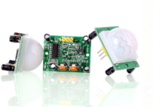
PIR SENSORS
Working range: 5M to 12 M.
Lower power consumption of 65mA.
Working voltage: 5V.
Output voltage: 3.3V.
It has three output pins:
Pin1:GND
Pin 2:Output which gives 3.5V when motion detected.
Pin3:VCC which provides supply voltage to PIR element and internal circuit.
It detects human or animal body movement in the area under the range.

Slide 6
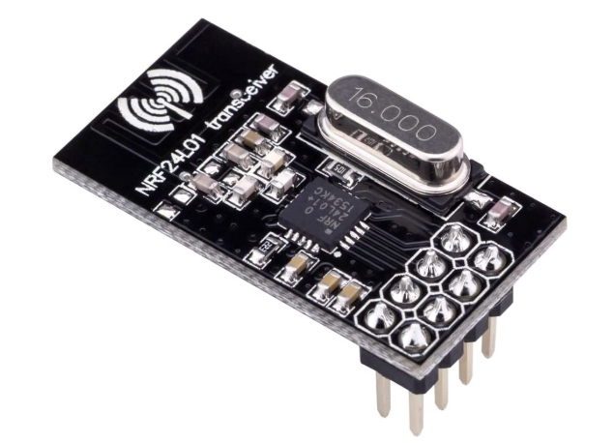
NRF24L01 RF TRANCEIVER
It is a 2.4GHZ transceiver
Operating voltage: 3.3V.
126 RF channels and common RX and TRX interface.
Fast AGC for improved dynamic range.
It operates at a band rate from 250 kbps to 2Mbps.
Operating range: 100 m.
Collecting binary signal from PIR sensors and passing to the LPC2148, in the form of analog signal.

Slide 7
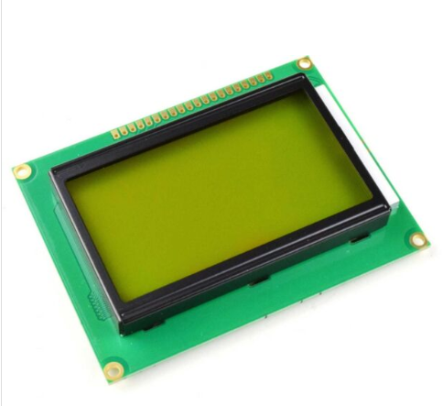
ST7920 GLCD
It has 128 * 64 LCD display based on ST7920 microcontroller.
Operating voltage range: 2.7V to 5.5V.
It supports 4 bit, 8 bit and serial MPU interface.
Supports 126 characters.
64 * 16 bit RAM.
Displays the current process in the system.

Slide 8
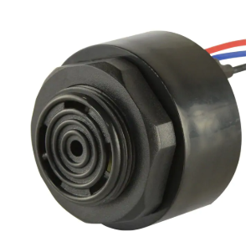
BUZZER
It contains an outer case with two pins attached, which is for power and ground.
Inside portion of a buzzer has central ceramic disc and enveloped by a metal vibrating disc.
Whenever current is applied to the buzzer makes the ceramic disc to vibrate and that makes alarm sound.
Alarm sound can regulate by means of adjusting the potentiometer.
Makes alarm sound to notify the user about theft.

Slide 9
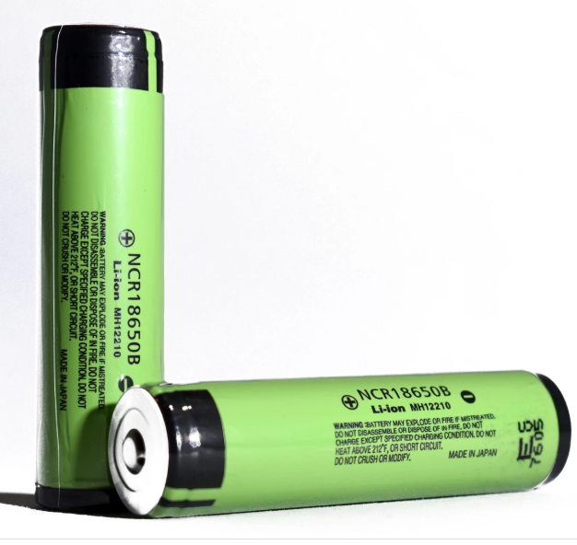
18650 LI-ION BATTERY
It is a lithium battery with size of 18mm * 65 mm, which is a rechargeable and used for portable electronics.
Nominal voltage: 3.6V.
Charging time: 3 hours.
Charging voltage: 4.2V.
Better thermal management.
Low cost.
Used to power up LPC2148.

Slide 10
REFERENCES
1. LPC2148 product data sheet (12 Aug 2011). Retrieved from: https://www.nxp.com/docs/en/data-sheet/LPC2141_42_44_46_48.pdf
2. ESP32 CAM module. Retrieved from: https://loboris.eu/ESP32/ESP32-CAM%20Product%20Specification.pdf
3.electronicwings. PIR sensors: sensors and modules. Retrieved from: https://www.electronicwings.com/sensors-modules/pir-sensor
4. Sitronix. (October 2002). ST7920 GLCD data sheet. Retrieved from: https://www.waveshare.com/datasheet/LCD_en_PDF/ST7920.pdf
5.Nordic semiconductor. NRF24L01 Single chip 2.4GHZ transceiver specifications. Retrieved from: https://www.sparkfun.com/datasheets/Components/SMD/nRF24L01Pluss_Preliminary_Product_Specification_v1_0.pdf
6. 18650 Lithium iron battery data sheet(Nov 2010). Retrieved from: https://www.ineltro.ch/media/downloads/SAAItem/45/45958/36e3e7f3-2049-4adb-a2a7-79c654d92915.pdf

